Slide 1
The Way Ahead
Notes:
We've reached the end of the course. We hope you enjoyed it, and found it interesting, informative, and fun.
So… what next?

Slide 2
Recap of what we've covered
Programming fundamentals
Getting started with Java
Core Java syntax
Flow of control concepts
Flow of control in Java
Writing and calling methods
Introduction to classes and objects
Defining your own classes
Initialization
Notes:
Here are some of the chapters we covered. Happy memories?

Slide 3
Some more stuff we've covered ☺
Introduction to arrays and collections
Introduction to inheritance
Inheritance in Java
Interfaces and abstract classes
Exception handling
Java 8 features
Notes:
Here are the chapters in the latter part of the course. We hope it all made sense, all the way to the end!

Slide 4

Where do you go next?
It's really important you get a chance to practise writing Java code
  Try out some of the additional exercises
  Look at samples online
  Ask some of your colleagues to see some of their code, if this is feasible
For exam preparation:
  Have a go at some mock exams
  for OCJA - practice makes perfect
  Make sure you understand the
  exam format and structure
Notes:
Attending this course is an important first step. The next steps are to consolidate your knowledge and fluency through practice, and to attempt as many OCJA mock exams as possible. This will help you understand what to expect in the exam, and be able to answer the questions correctly.

Slide 5
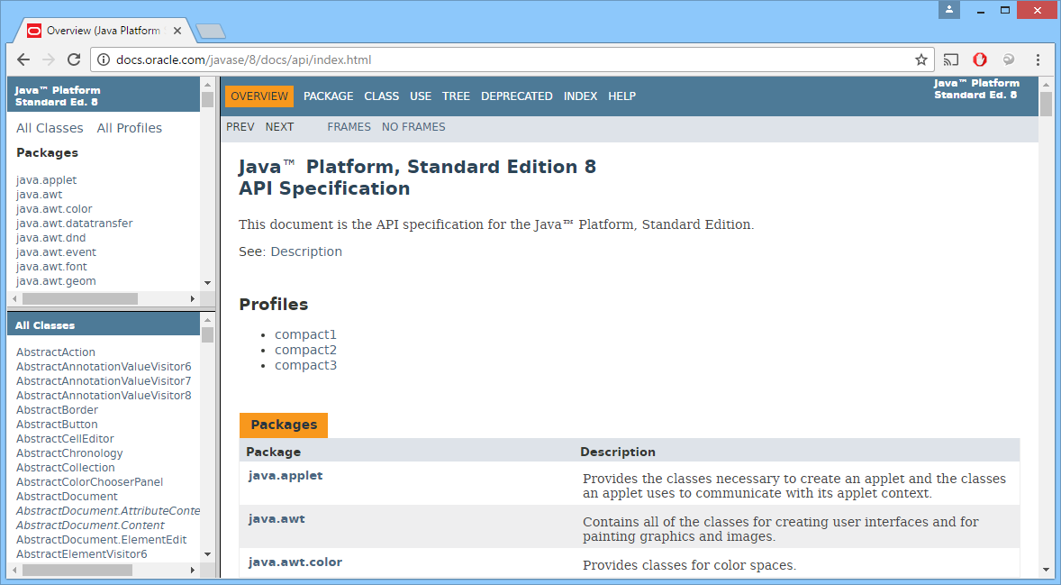
Using JavaDoc documentation
For full documentation online about all the standard Java classes, see:
  http://docs.oracle.com/javase/8/docs/api/index.html
Notes:
Full Java SE documentation is available online. You can get all the information you'll ever need here!

Slide 6
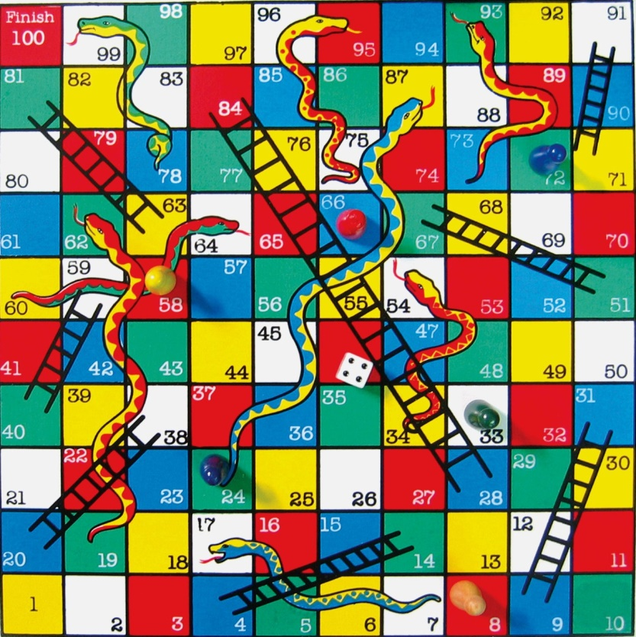
Practice
We've included an assignment with the course materials
  A chance to practice your Java programming skills
Notes:
The course materials include an assignment that gives you a chance to practice your new-found Java programming skills.
The assignment is a simulation of a Snakes and Ladders game, as shown in the picture above. You're not expected to implement a full-on graphical user interface, just the game-play logic.
For full details of the assignment, see the following document:
Assignment - Snakes and Ladders.docx
A full solution is available in the following folder (this is an Eclipse project, which you can import into Eclipse when you’re finished, to compare your application with our solution):
C:\OcjaDev\Assignment\SolutionSnakesAndLadders

